Slide 1

Regression Analysis
By:
Muhammed Sezer &
Şevval Belkıs Dikkaya

Slide 2
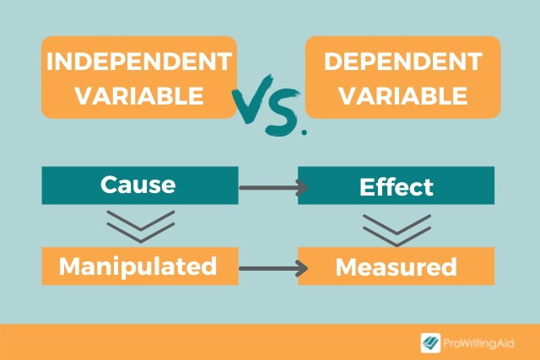

Slide 3
Predicting Exam Scores Based on Study Time

Slide 4
REAL ESTATE MARKET
Housing Prices

Slide 5
REAL ESTATE MARKET
Location
Square Footage
# of Bedrooms
Age of the property
Proximity to Amenities etc.
Housing Prices

Slide 6

predictions & inform decision-making

Slide 7



Examples of specific applications of regression analysis:
Linear Regression
Logistic Regression
Poisson regression

Slide 8
Theoretical Background
The general form of the regression equation is given as follows:
Y = f(X1, X2, ..., Xp) + ϵ
where f(X1, X2, ..., Xp) is the functional form of the relationship between the dependent variable and the independent variables, and ϵ is the error term, which captures the random variation in the dependent variable that is not explained by the independent variables.

Slide 9

Basic Regression Models
Linear Regression
Polynomial Regression
Logistic Regression
Time Series Regression

Slide 10
Assumptions:
• Linearity: The relationship between the dependent variable and the independent variables is linear.
• Independence: The error terms are independent of each other.
• Homoscedasticity: The variance of the error terms is constant across all levels of the independent variables.
• Normality: The error terms are normally distributed.
• Linearity of independent variables and log odds: The relationship between the independent variables and the log odds of the dependent variable is linear.
• Absence of multicollinearity: The independent variables are not highly correlated with each other.
• Stationarity: The time series data should be stationary, i.e., the mean, variance, and autocorrelation structure do not change over time.
• Large sample size: The sample size is large enough to ensure stable parameter estimates.

Slide 11

1. Linear Regression Models
where β0 is the intercept, β1, β2, ..., βp are the coefficients, and X1, X2, ..., Xp are the independent variables.
Assumptions:
Linearity
Independence
Homoscedasticity
Normality

Slide 12
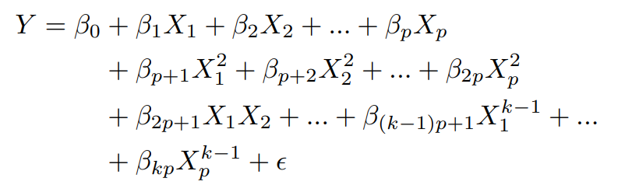
2. Polynomial Regression Models
where β0 is the intercept, β1, β2, ..., βp are the coefficients of the first-order terms, βp+1, βp+2, ..., β2p are the coefficients of the second-order terms, β2p+1, ..., β(k−1)p+1 are the coefficients of the interaction terms, and βkp are the coefficients of the kth-order terms. X1, X2, ..., Xp are the independent variables, and ϵ is the error term.
Assumptions:
Linearity
Independence
Homoscedasticity
Normality

Slide 13
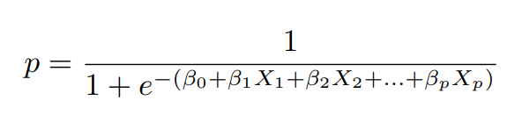
3. Logistic Regression Models
Assumptions:
Linearity of independent variables and log odds
Independence
Absence of multicollinearity
Large sample size
where β0 is the intercept, β1, β2, ..., βp are the coefficients, and X1, X2, ..., Xp are the independent variables.
The logistic function is a sigmoidal function that ranges from 0 to 1, representing the probability of the dependent variable being in the ”success” category. One advantage of logistic regression is that its derivative is easy to calculate and is defined, which is useful for optimization algorithms that require gradient information.

Slide 14

4. Time Series Regression Models
where Yt is the dependent variable at time t, β0 is the intercept, β1, β2, ..., βp are the coefficients, X1t, X2t, ..., Xpt are the independent variables at time t, and ϵt is the error term at time t.
Assumptions:
Linearity
Stationarity
Absence of multicollinearity
No autocorrelation
Homoscedasticity
Normality

Slide 15

Performance of Regression Models (Error Functions)
Error functions are used to measure the difference between the predicted values and the actual values in a regression model.
The goal is to minimize this difference to obtain the best-fit line.

Slide 16
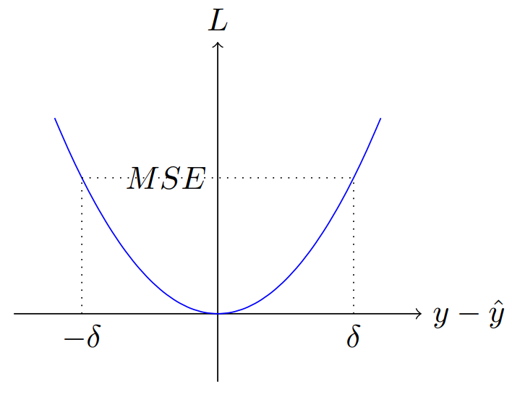
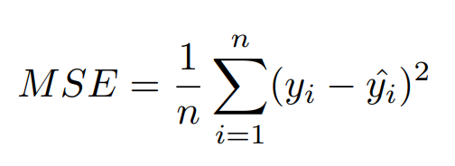
Mean Squared Error (MSE)
Penalizes larger errors more severely than smaller errors
Measures the average of the squared differences between the predicted values and the actual values
Ex: Predicting the Lifespan of Lithium-Ion Batteries

Slide 17
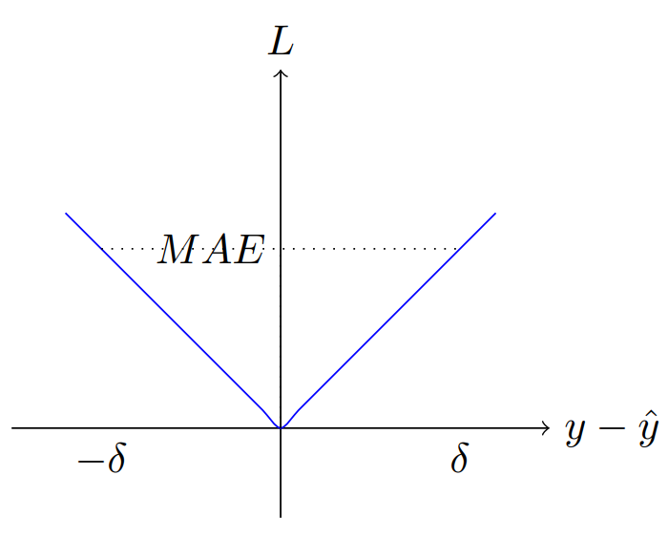
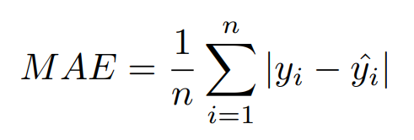
Mean Absolute Error (MAE)
Measures the average of the absolute differences between the predicted values and the actual values
penalizes all errors linearly
less sensitive to outliers compared to MSE
Ex: Predicting Delivery Times for a Logistics Company

Slide 18
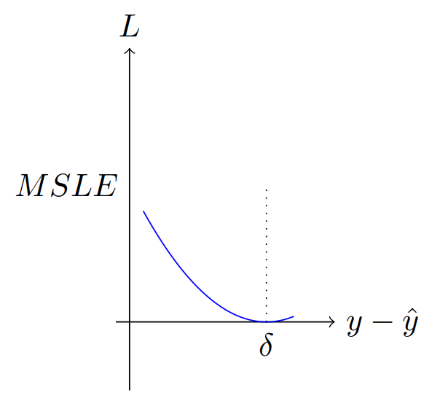
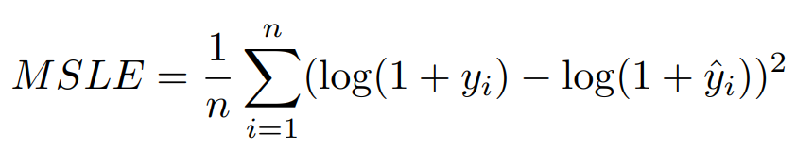
Mean Squared Logarithmic Error (MSLE)
Measures the average of the squared differences between the logarithms of the predicted values and the actual values
Less sensitive to large differences between the predicted and actual values when both are large (helps focus on relative errors rather than absolute errors)
Useful when modeling growth rates or multiplicative factors
Ex: Predicting the Number of Daily Visitors to a Website

Slide 19
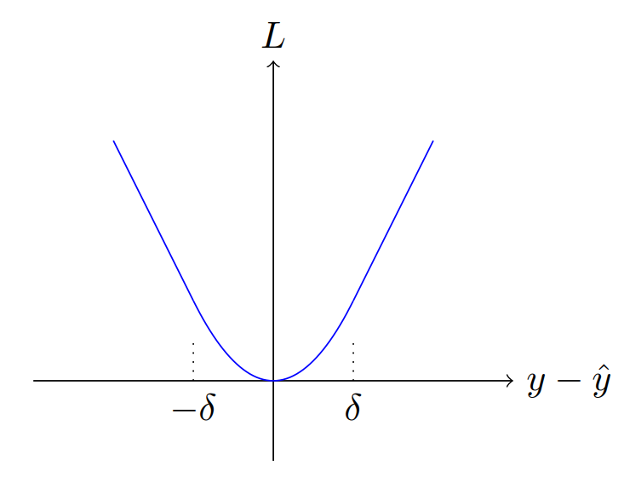
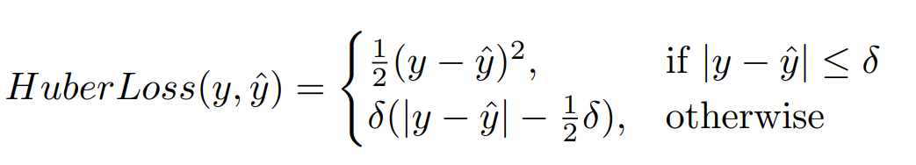
Huber Loss
Combination of the mean squared error (MSE) and the mean absolute error (MAE)
Quadratic for errors smaller than threshold and linear for errors larger than threshold
By adjusting the δ parameter, we can control the transition point between the quadratic and linear regions of the loss function, allowing us to fine-tune the model’s sensitivity to outliers
Ex: Predicting Electricity Consumption for a Smart Grid

Slide 20
Suitable Model Selection
The nature of the data:
Consider the type of data you are working with (e.g., continuous, binary, count data) and the relationships between variables (linear, nonlinear, time-dependent).
Model complexity:
Choose a model that is neither too simple nor too complex. A simple model may not capture the underlying relationships in the data, while a complex model may overfit the data.
Interpretability:
In some cases, it is essential to have a model that is easy to interpret and understand.

Slide 21
Loss Function Selection
The type of problem: Different loss functions are suitable for different types of problems, such as regression, classification, or ranking.
The distribution of the data: Some loss functions may be more suitable for data with specific characteristics, such as skewed or heavy-tailed distributions.
The impact of outliers: If your data contains outliers, you may want to choose a robust loss function that is less sensitive to extreme values.

Slide 22

Practical Use of Regression
Data Preparation and Preprocessing
Model Training and Evaluation
Feature Selection and Engineering
Regularization and Overfitting

Slide 23
Data Preparation and Preprocessing
Cleaning the Data
Correcting data entry errors, inconsistencies, and duplicate records
Ensuring that the data is in a suitable format
Handling Missing Values
Removing records with missing values
Imputation
Using models that can handle missing values directly (decision trees, random forests etc.)
Transforming Variables
Logarithmic transformation
Standardization
Categorical encoding
Variable Selection
Identifying relevant independent variables based on domain knowledge or literature review

Slide 24
2. Model Training and Evaluation
Training the Regression Model
Select appropriate regression algorithm
Tune hyperparameters (learning rate, regularization strength, or the degree of a polynomial)
Evaluating the Model on a Test Set
Test the performance on unseen data
Model Evaluation Metrics
MSE, RMSE, MAE
Compare its performance to a baseline (performance of a simple linear regression model etc.)

Slide 25

3. Feature Selection and Engineering
Feature Selection
Reducing the number of input features (filters, wrapper methods, embedded methods)
Feature Engineering
Creating new features from existing ones (transformations, interaction terms, polynomial features, domain-specific features)

Slide 26
4. Regularization and Overfitting
Regularization
Adding penalties to the model coefficients (LASSO, Ridge etc.)
Overfitting
Regularization
Feature Selection
Cross-validation

Slide 27
Practical Applications
Finance and Economics
Engineering and Natural Sciences
Machine Learning Applications

